Slide 1
What Can Ticket to Work Do For You?
Notes:
Add a title and any information you choose about the presentation. Please note that each slide has been set up to allow you to put your logo/company name at the top.

Slide 2
Participation in Ticket to Work allows:
Access to a wide variety of free employment services
Connection with a knowledgeable service provider called an Employment Network (EN)
Support by your “Employment Team” on your journey to financial independence
Notes:
By participating in the Ticket to Work program, you will:
have access to a wide variety of free services provided to you by Ticket to Work service providers, also known as Employment Networks (EN's). These EN's will become your “Employment Team,” ready to support you on your journey to financial independence.

Slide 3
What is Ticket To Work?
Established by Social Security Administration (SSA)
Eligibility: Ages 18-64, currently receiving SSI/SSDI benefits
Goal: Supports career development for individuals wanting to work and become self-sufficient
Participation: Free and voluntary program
Source: www.choosework.net
Notes:
Established by Social Security Administration (SSA)
Eligibility: For disability beneficiaries, Supplemental Security Income and Social Security Disability Income, age 18-64
Supports career development for people with disabilities who want to work with the goal of becoming self-sufficient
A free and voluntary program
Services provided by Employment Networks
Taken from www.chosework.net

Slide 4
Goals of the Ticket to Work Program
Start working at least part-time during first nine months after Ticket assignment with goal of becoming self supporting
After nine months, earn Substantial Gainful Activity for 11-18 months
Earn Substantial Gainful Activity and be completely off of cash benefits
Maintaining medical benefits

Slide 5
What is an Employment Network (EN)?
A private or public organization whose goal is to get you back to work!
Services vary, but all provide career counseling, job placement assistance and help maintaining long term employment
EN will work with you to jointly develop a plan that details your career goals and joint responsibilities
Notes:
A private or public organization that can help with career counseling and assistance with job placement.
Provides a variety of services to assist beneficiaries in finding and maintaining long term employment.
Funded by the Social Security Administration to provide employment services at no cost to job seekers.

Slide 6
Services We Provide:
Career Counseling
Job Leads
Individual Work Plan
Work Incentive Counseling Referrals/Planning
Resume Preparation
Labor Market Information
Training/Referrals
Practice Interviewing
Retention Services
Notes:
ENs: Add/delete specific services that fit your EN.

Slide 7
Benefits of Ticket to Work
Access to Employment/Career Services
Protection from Continuing Disability Reviews (CDR)
Assistance with Wage Reporting
Work Incentive Counseling Referral/Planning
Expedited Reinstatement of Benefits
Your own personal employment team!

Slide 8
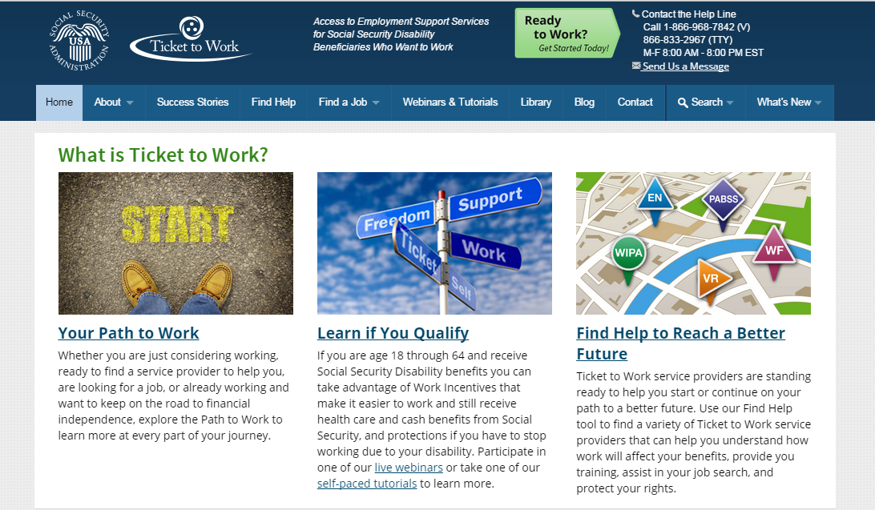
Valuable Resource: www.choosework.net

Slide 9
What is the Work Opportunity Tax Credit?
The Work Opportunity Tax Credit (WOTC) is a Federal tax credit available to employers for hiring individuals from certain targeted groups who have consistently faced significant barriers to employment.
Veterans
Ex- Felons
Summer Youth Referrals
Vocational Rehabilitation Referrals
SNAP Recipient
SSI Recipient
TANF Recipient

Slide 10
Questions

Slide 11
America Works of Louisiana, Inc.
Director: Stacy Morgan
650 Poydras Street, Suite 1400
New Orleans, LA 70130
T: 504-299-3464
www.americaworks.com/tickettowork
Notes:
Ad your company logo and contact information

