Slide 1

Promoting Inclusive Growth in New Orleans
Introducing Public and private participation geographic information systems (p3GIS)
New Orleans City Council, Economic Development Committee December 10, 2019
Mastercard Center for Inclusive Growth
Michelle M. Thompson, PhD, GISP, FRGS
Data Fellow

Slide 2



PROJECT OVERVIEW
Understanding Financial Inclusion in New Orleans
Businesses and governments increasingly rely on consumer and user insights to decide where to invest. Those insights can have a positive impact on lower income and underserved communities if the investments are applied across a wider socio-economic spectrum. A comprehensive and integrated data solution that provides a more complete picture of community wealth and purchasing power.
The project was initiated in 2018-2019 as part of the New America Public Interest Technology Program where Thompson served as a Technologist focused on Inclusive Growth: https://www.newamerica.org/public-interest-technology/blog/financial-inclusion-citizen-participation-project-bridging-data-gap-low-income-communities/
p3GIS
Public data
Open source data which is provided by
Federal
State
Local
Community GIS data
Neighborhood knowledge collected in and for community
Oral history
Neighborhood Engagement
Primary data collection
Private data
Typically limited access confidential information transformed into anonymized & aggregated data
Non-profit business
For-profit business
Public and Private Participation Geographic Information Systems

Slide 3
Data for Good Project Datathon & Insights History and TimeLine
October 2018: Thompson began as a Data Fellow working with Edward Lee, Data Scientist at the Mastercard Center for Inclusive Growth, to evaluate the potential uses of the 3 years of anonymized and aggregated Mastercard transaction data in identifying growth trends by various industries. Followed extensive data safety and security protocol for this unique data for good collaboration.
February 2019: A team of 60+ Mastercard Datathon Data Scientists over 36 hours providing 1,000+ volunteer hours at legacy APT’s Mastercard Office in Washington, DC. which creates initial data insights.
May 2019 Using data insights, Thompson/Lee 3 expanded research for the New Orleans market: place-based development strategy using the Livable Claiborne Corridor/Claiborne Corridor Cultural Innovation District; Qualified Opportunity Zones; Tourism.
Summer/Early Fall 2019: Engaged p3GIS model through sharing Livable Claiborne Corridor/Claiborne Innovation District insights with NOLA stakeholders: community, non-profits, academy, and municipal government.
October 2019: Results of data insights published in Using Data-Driven Insights to Help Revive a Historic New Orleans Neighborhood

Slide 4
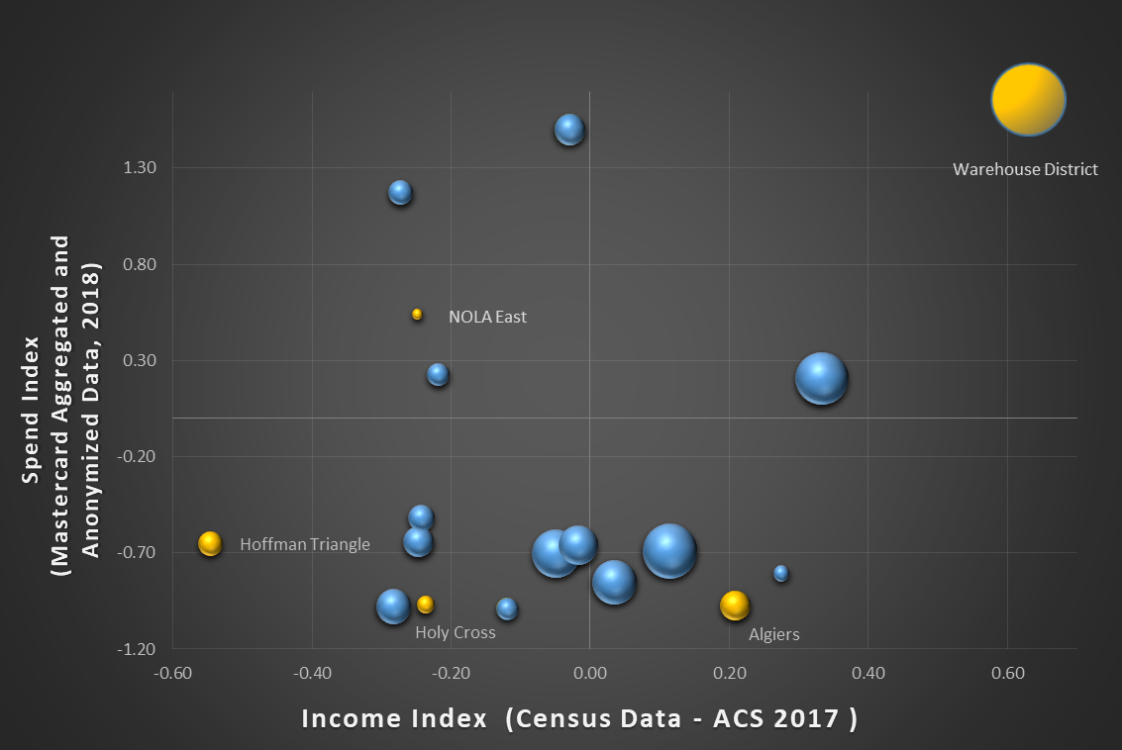
New Orleans Qualified Opportunity Zones
Examining the spend index using Mastercard aggregated and anonymized data for 2018 with US Census Data Income Index from the American Community Survey, 2017.
Findings:
Not All New Orleans Qualified Opportunity Zones are Equal and need customized development strategies based on community needs.

Slide 5
Livable Claiborne Corridor /
Claiborne Corridor Cultural Innovation District
New Orleans Census Tracts seamlessly align with Neighborhood boundaries. The LCC boundaries do not completely incorporate all neighborhood boundaries/census tracts.
The LCC and, almost all of the CID, are entirely encompassed by Opportunity Zones.

Slide 6
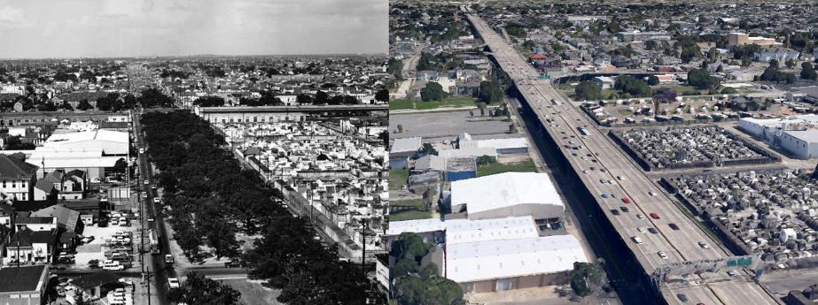

Livable Claiborne corridor (LCC) /
Claiborne corridor cultural innovation district (CCCID/CID)
  Datathon Focus:
  Demonstrate the use of public and private data to evaluate financial health of businesses.
  Have public and private investments changed inside and outside the LCC/CCCID? (buffer)
  What are the socio-economic and demographic changes been from 2013 – 2017 using US Census American Community Survey data?
  How have small businesses performed in and outside of the LCC/CCCID as compared to the rest of the city?
Source: Louisiana Division/City Archives, New Orleans Public Library

Slide 7
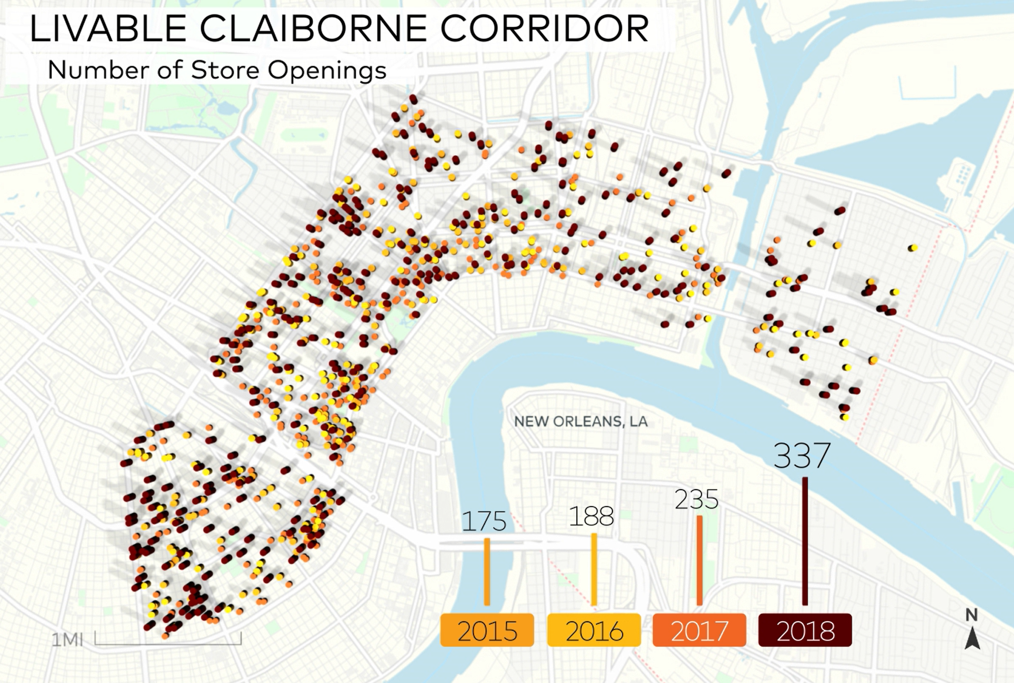
New Store Openings in the Livable Claiborne Corridor Accelerate in 2018

Slide 8
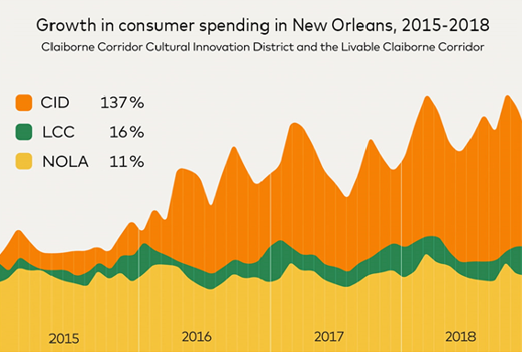
Spend in the CID Grew 12 Times Faster Than the Rest of New Orleans

Slide 9
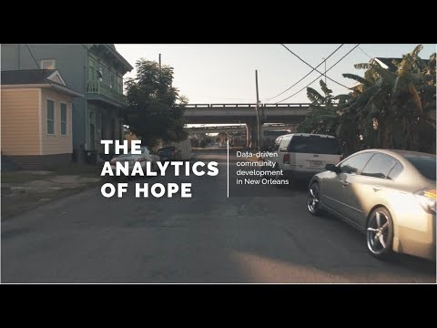
Questions?
“Using Data-Driven Insights to Help Revive a Historic New Orleans Neighborhood” article
https://www.mastercardcenter.org/insights?type=Data-Insights
“The Analytics of Hope: Data-Driven Community Development in New Orleans” video
https://www.washingtonpost.com/brand-studio/mastercard/the-analytics-of-hope/

